Slide 1
Final Engagement
Attack, Defense & Analysis of a Vulnerable Network

Slide 2
Table of Contents
This document contains the following resources:
Network Topology & Critical Vulnerabilities
Exploits Used
Methods Used to Avoiding Detect

Slide 3

Network Topology
& Critical Vulnerabilities
‹#›

Slide 4

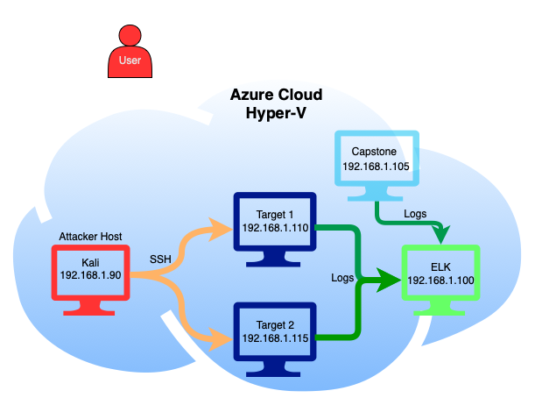
Network Topology
Machines
IPv4: 192.168.1.100
OS: Linux
Hostname: ELK
IPv4: 192.168.1.105
OS: Linux
Hostname: Capstone
IPv4: 192.168.1.110
OS: Linux
Hostname: Target 1
IPv4: 192.168.1.115
OS: Linux
Hostname: Target 2
Attacker
IPv4: 192.168.1.90
OS: Linux
Hostname: Kali
Network
Address Range: 192.168.1.0/24
Netmask: 255.255.255.0
Gateway: 10.0.0.1
Notes:
Target 1 and 2 send metrics to ELK stack, Kali SSH into target 1 to compromise. Capstone to test alerts.

Slide 5


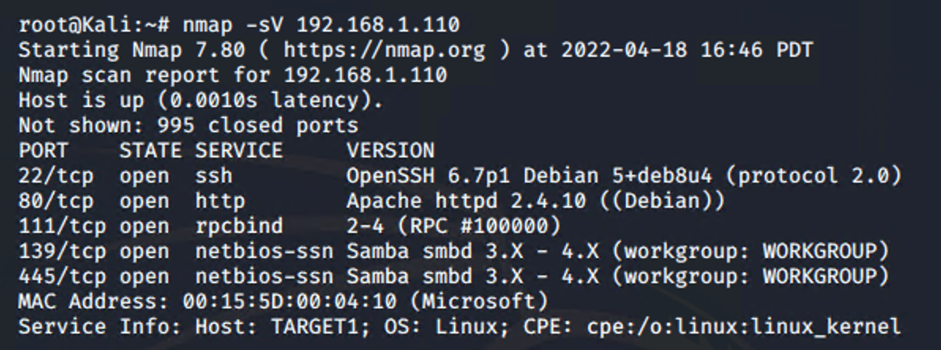
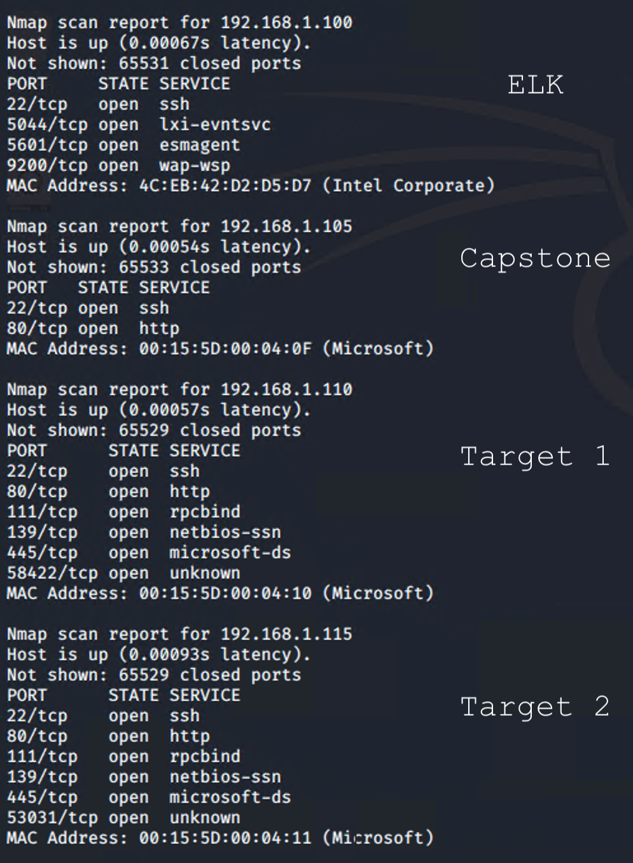
NMAP Scans
TARGET 1
VULNERABLE
SOFTWARE
VULNERABLE
OPEN PORTS
OPEN PORTS AND OUT OF DATE SOFTWARE LEADS TO NUMEROUS VULNERABILITIES

Slide 6
Critical Vulnerabilities: Target 1
Vulnerability | Description | Impact
WordPress Enumeration | A scan that can enumerate usernames | Gave login credentials
Weak Passwords | Users had weak/easily accessible passwords | Allowed to gain access to authorized user
CVE-2006-0151 | Python privilege escalation | Privilege Escalation to Root

Slide 7
Exploits Used
‹#›

Slide 8
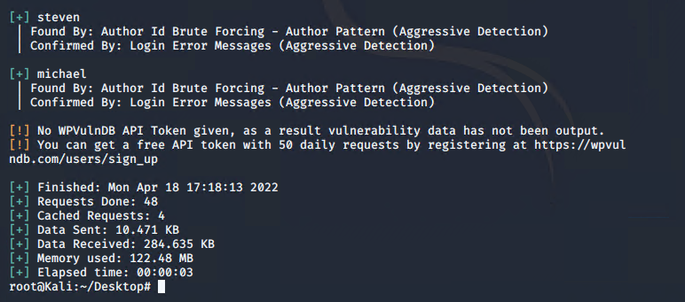

Exploitation: Wordpress Exposed login info
We were able to utilize WPScan to enumerate user accounts that were on the server
This exploit allowed us to steal authorized usernames to gain access to the server
Daily reminder to not list user names in plain text on unsecured web servers If you can help it

Slide 9
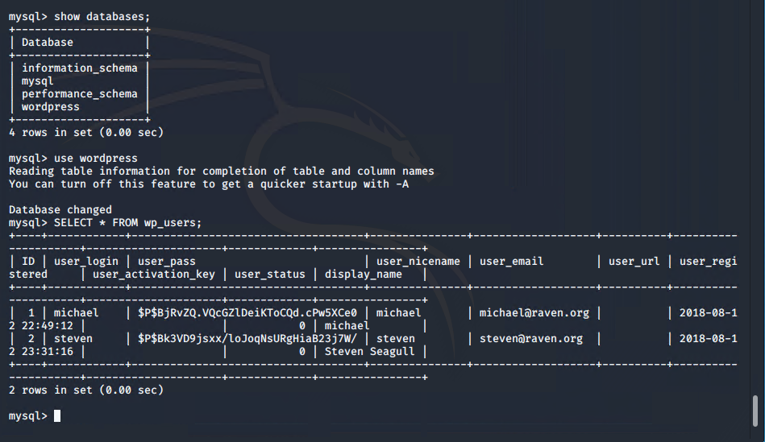
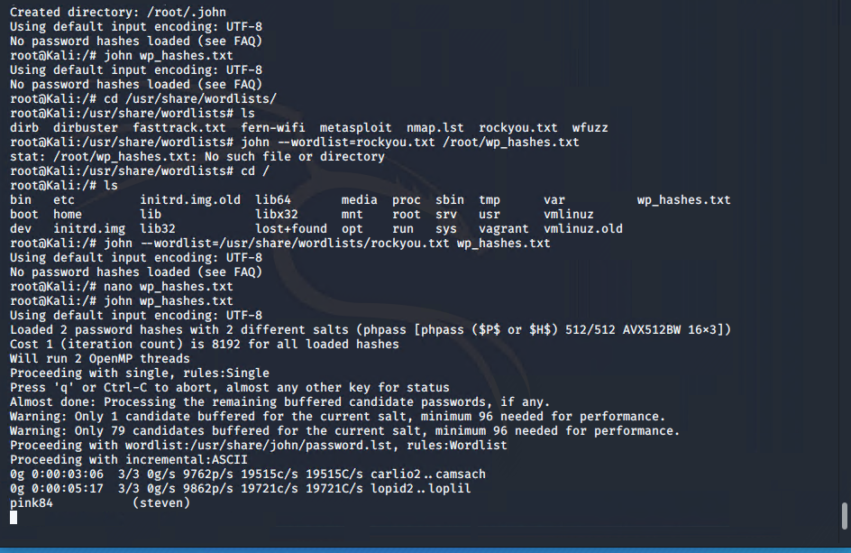
Exploitation: [Weak Passwords]
Using brute force for Michael’s password and using the MySQL database to find password hashes, also using John the Ripper to gain User Steven’s password
Able to access Users and gain access to files and passwords with information we could use to exploit and find target flags.

Slide 10

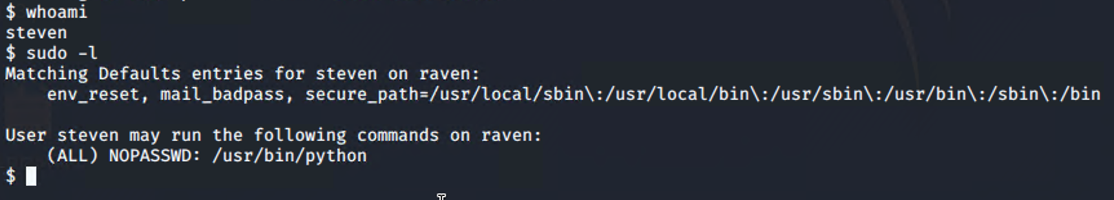
Exploitation: [CVE-2006-0151]
An exploit which allows limited local users to gain privileges via a Python script. While in user Steven was able to run sudo -l and saw that he was able to run Python as root.
By running the command to use python was able to escalate privileges and gain a root shell.

Slide 11
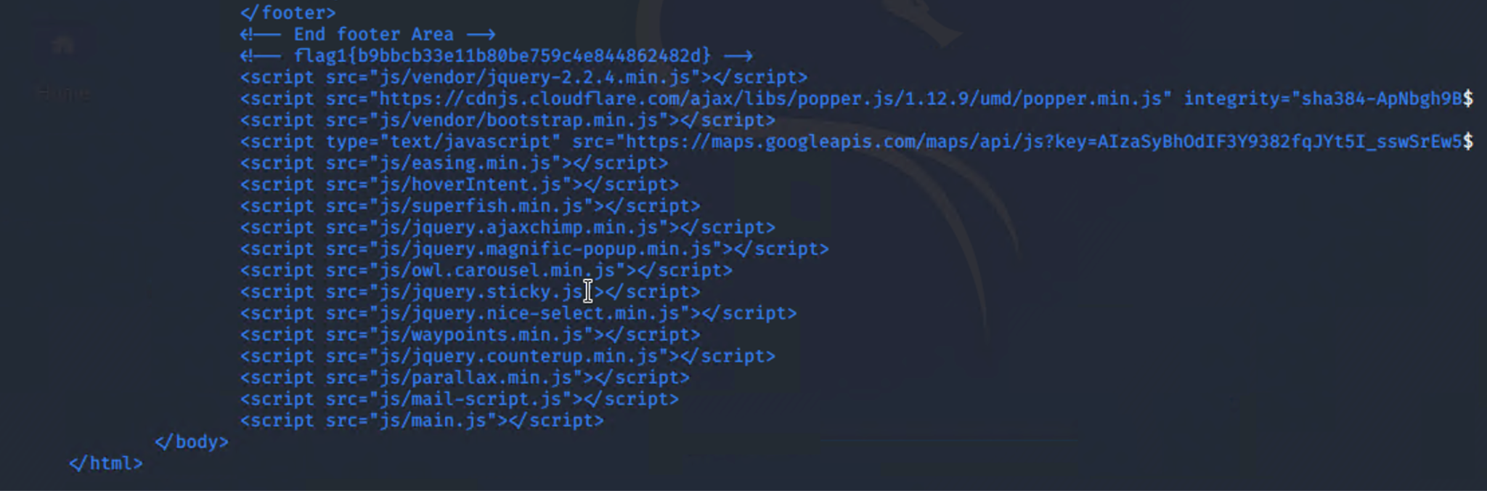
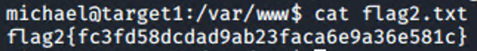
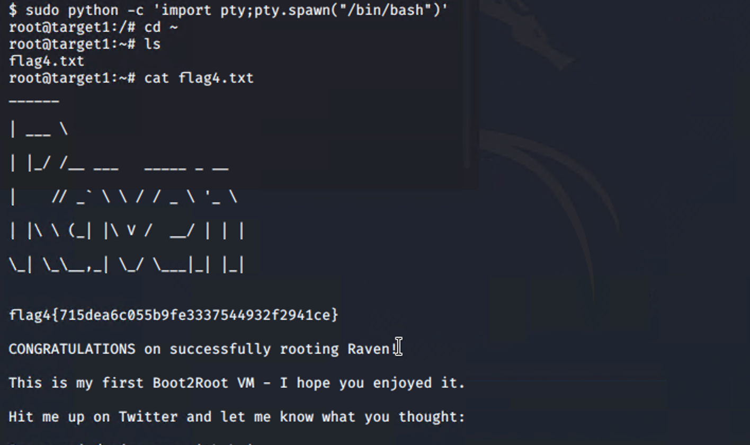
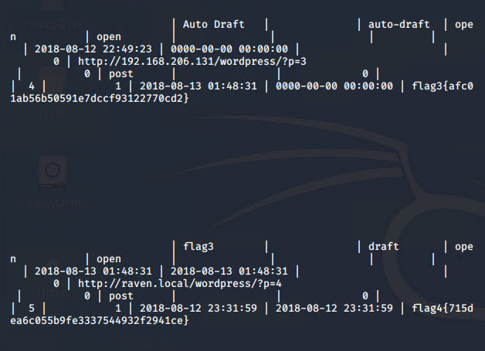
FLAGS
FLAG 1
LOCATION: /var/www/html/service
VULNERABILITY EXPLOITED: weak passwords
FLAG 2
LOCATION: /var/www/
VULNERABILITY EXPLOITED: weak passwords
FLAG 4
LOCATION: target 1 root
VULNERABILITY EXPLOITED: python privilege escalation
FLAG 3
LOCATION: wordpress mysql database
VULNERABILITY EXPLOITED: wordpress

Slide 12
Avoiding Detection
‹#›

Slide 13
Stealth Exploitation of Wordpress User Enumeration
Monitoring Overview
Which alerts detect this exploit?
WHEN count() GROUPED OVER top 5 ‘http.response.status_code’ IS ABOVE 400 FOR THE LAST 5 minutes
Which metrics do they measure?
http.response.status_code
Which thresholds do they fire at?
above 400
Mitigating Detection
Are there alternative exploits that may perform better?
gobuster could also work as an alternative, but may also flag SIEM
https://www.kali.org/tools/gobuster/

Slide 14
Stealth Exploitation of Local File Inclusion (LFI)
Monitoring Overview
Which alerts detect this exploit?
WHEN sum() OF http.request.bytes OVER all documents IS ABOVE 3500 FOR THE LAST 1 minute
Which metrics do they measure?
http.request.bytes
Which thresholds do they fire at?
Above 3500
Mitigating Detection
How can you execute the same exploit without triggering the alert?
Limit size of files below 3500 bytes of information
https://www.cobalt.io/blog/a-pentesters-guide-to-file-inclusion#:~:text=Local%20file%20inclusion%20(also%20known,procedures%20implemented%20in%20the%20application.

Slide 15
Stealth Exploitation of Directory Traversal
Monitoring Overview
Which alerts detect this exploit?
WHEN max() OF system.process.cpu.total.pct OVER all documents IS ABOVE 0.5 FOR THE LAST 5 minutes
Which metrics do they measure?
system.process.cpu.total.pct
Which thresholds do they fire at?
0.5 (50% of cpu usage)
Mitigating Detection
How can you execute the same exploit without triggering the alert?
Utilizing Google Dorking to find “invisible” directories and/or text documents that can provide info without setting off alarms
https://www.acunetix.com/websitesecurity/directory-traversal/

Slide 16
Thank you!
Presentation by:
Arthur
Max
Kieran
George
Steph

